Slide 1
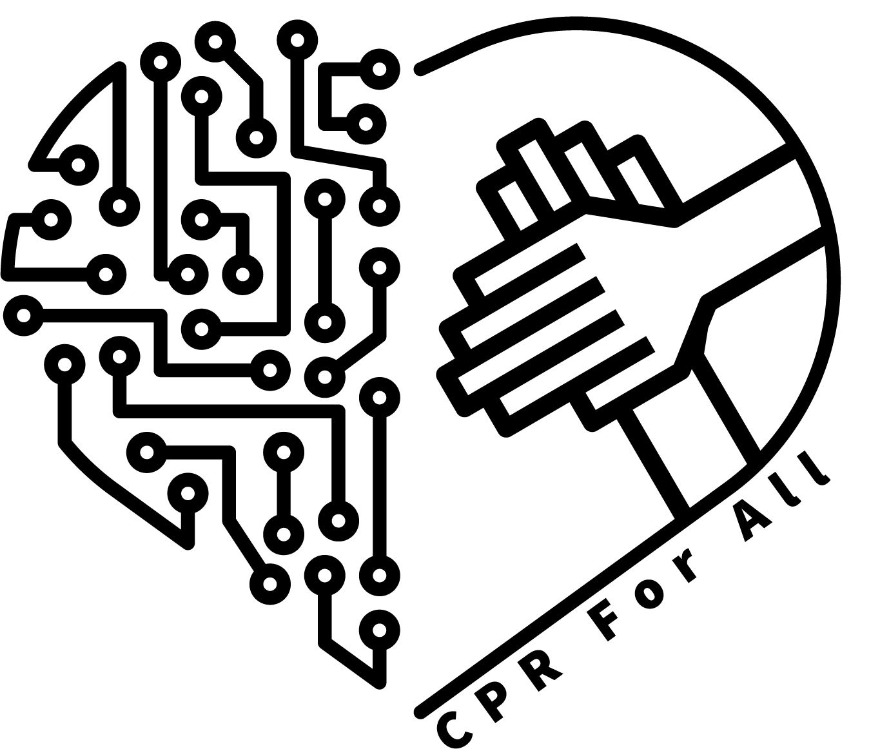
Cardiopulmonary
Resuscitation
CPR For All
Members:
Tom Maloney, Ph.D. (Weill Cornell)
Kristen Flaherty, Shou-Kai Cheng, Siqi Ke (Cornell Tech)
Project Mentor:
Emily Chien, M.D. (Weill Cornell)
General Mentor:
Niti Parikh, Professor (Cornell Tech)
Michele Fuortes, M.D. (Weill Cornell)
Sebastian Bidegain, M.D. (Cornell Tech & Weill Cornell)

Slide 2
Agenda
01
04
02
05
03
06
The Challenge
Project Goals & Constraints
Design Challenge Framework
Proof of Concept Design
User Groups & Needs
Our Roadmap
Notes:
Area of inquiry within overall theme present to you by your organization
Design Challenge Framework
User Group & Need defined
Project Goals
Roadmap to achieve your goals

Slide 3
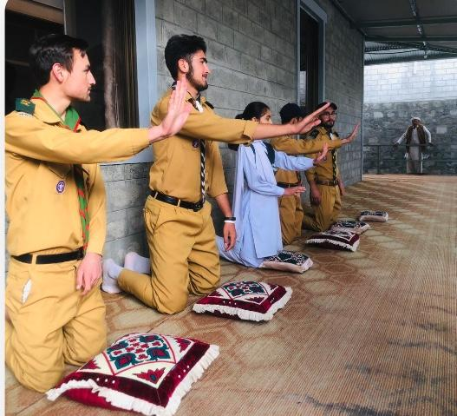

The Challenge
CRP For All
How Might We create a low-cost version of a CPR model that appropriately simulates the compression force and depth required for high-quality CPR?
Notes:
Our challenge is inspired by the fact that the high cost of CPR model limits its availability to the bystander CPR learners at schools or community centers in Pakistan. Currently, they are using a combination of high-fidelity / high-cost mannequins pillows to teach learners how to perform CPR. We are wondering if we can find a better solution than the that.
Pakistan Life Savers Programme (PLSP) is a youth skill-building and empowerment program that aims to train 10 million people in hands-only CPR and bleeding control. It uses a train-the-train model to teach bystander CPR in various settings including schools or community centers. Currently, PLSP uses a combination of high-fidelity / high-cost mannequins pillows to teach learners how to perform CPR. Unfortunately, the high cost of mannequins limits its availability to all learners.

Slide 4
User Groups & Needs
School Children
College Students
Medical Students
6-12th Grade.
Bystander CPR
Pre-Med Students. Bystander CPR
Early year students. Bystander & Clinical CPR
Organizations
PLS & Trainers
General Public
Govt. workers, corporate employees.
Bystander CPR
Running and administering bystander CPR trainings.
Any layperson trainee in PLS Bystander CPR programs

Slide 5
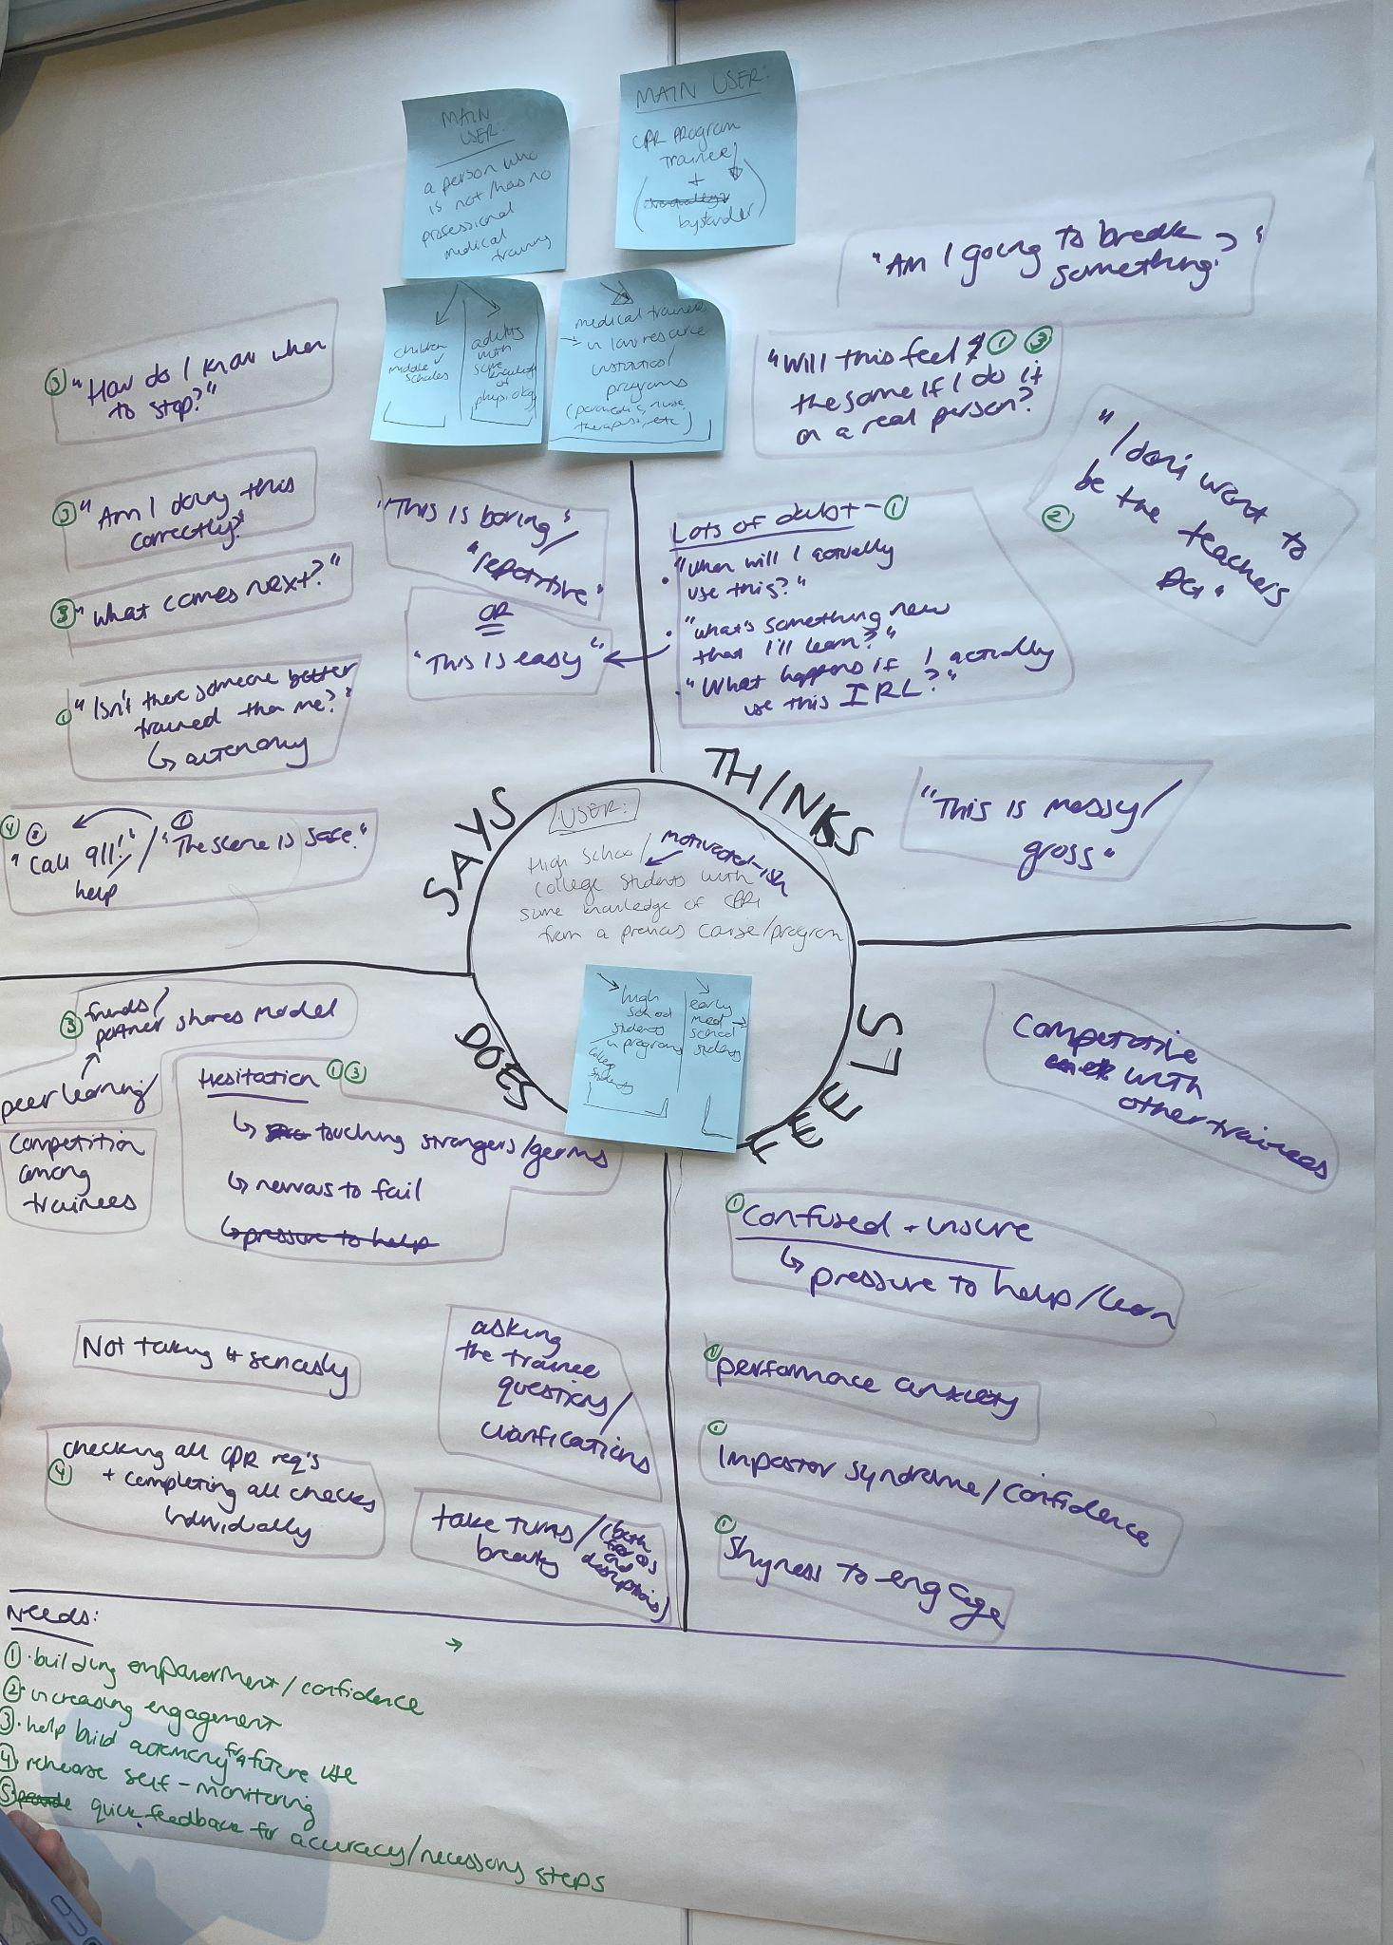
Design Challenge Framework
Components from empathy mapping:
Says: - How do I know when to stop? - Am I doing this correctly? - What comes next? | Thinks: - This is messy/gross! - Will this feel the same if I do it on a real person?
Does: - Hesitation to touch models or germs (Fear of failure). - Ask trainer more questions. | Feels: - Confused/unsure. - Imposter Syndrome. - Performance Anxiety.
Needs:
Building empowerment/confidence
Increase engagement
Help build accuracy
Enhance self-monitoring
Quick feedback

Slide 6
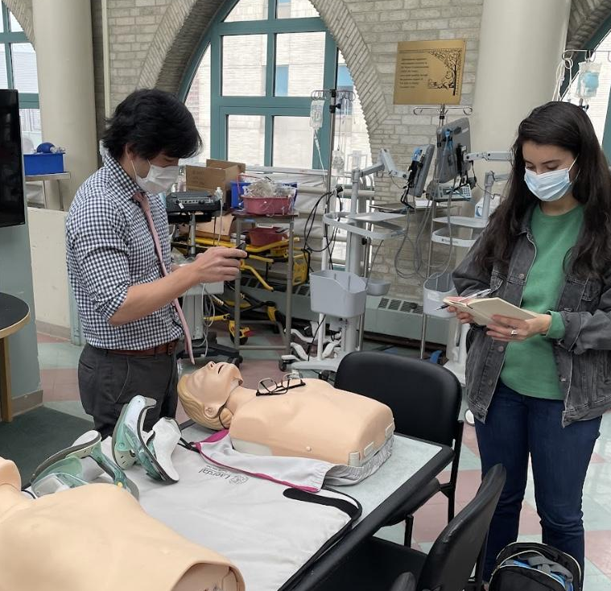
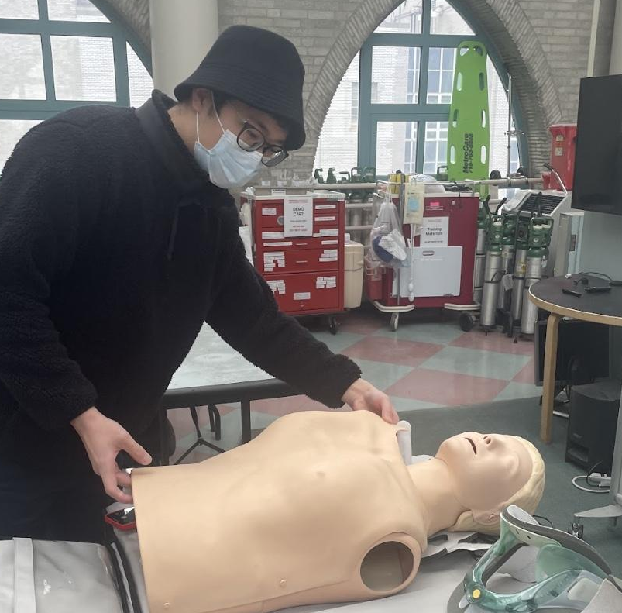
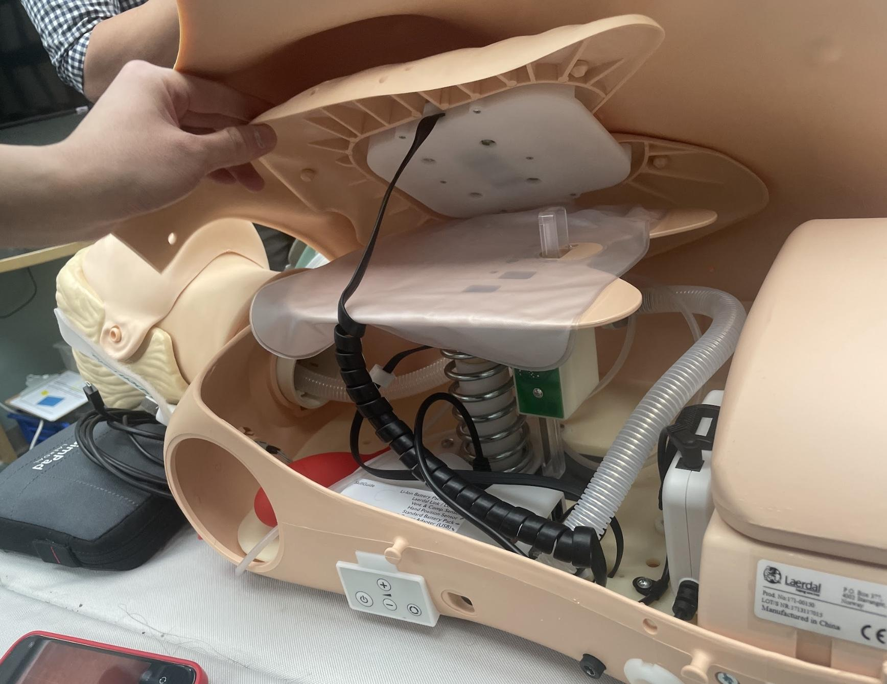
Interview
Takeaways
4 Emergency Medicine Physicians @ Weill Cornell
Pakistan Life Savers Program
Recent implementation of CPR into national education curriculum, ~10 million students 6th-12th grade
Every trainee has one pillow and shares an expensive training mannequin
Low resourced, high work output
Need an affordable, portable, scalable, reproducible CPR model to deploy in their programs
CPR Training
Compressions (depth, rate, hand placement, length) is necessary to teach in bystander CPR over ventilation
2-2.5 inches deep at 100-120 cpm for 2 minutes
Deliver high quality, intuitive feedback without increasing cost

Slide 7
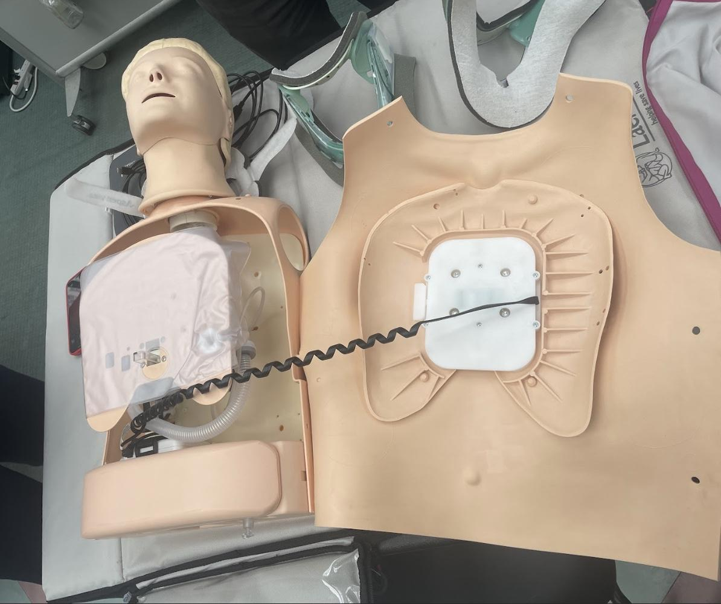
Project Goals & Constraints
Expensive
Highly Accurate Feedback
No Feedback
Cheap

Slide 8
Project Goals & Constraints
Goals
Compression only
Accurate depth and rate feedback
Scalable and portable for schools
Constraints
Low cost, affordable objects
Reproducible
Easy to assemble
Repairable

Slide 9
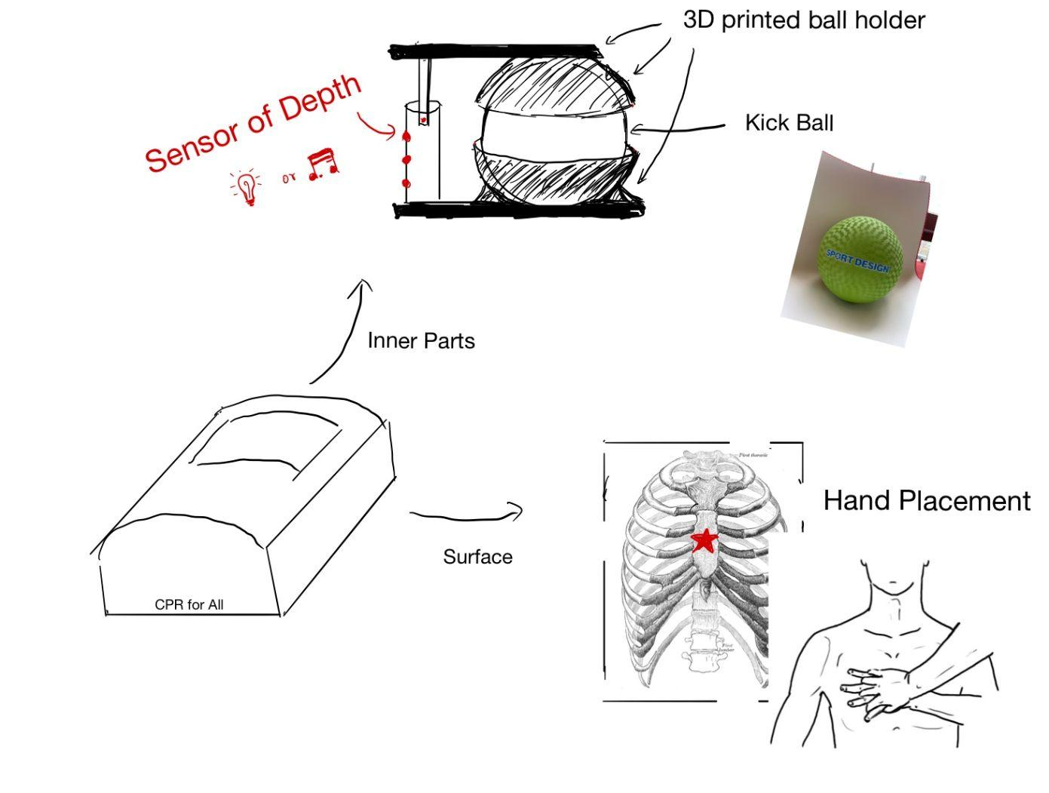
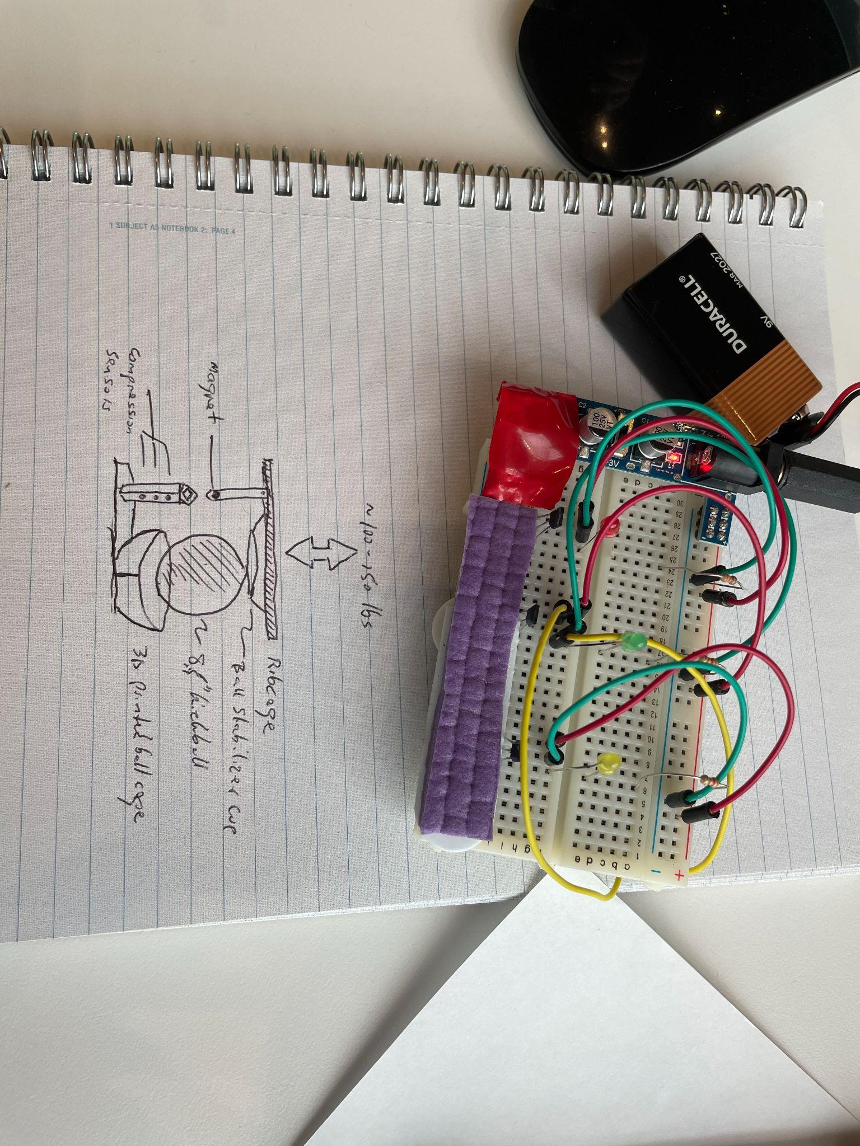
Prototype

Slide 10
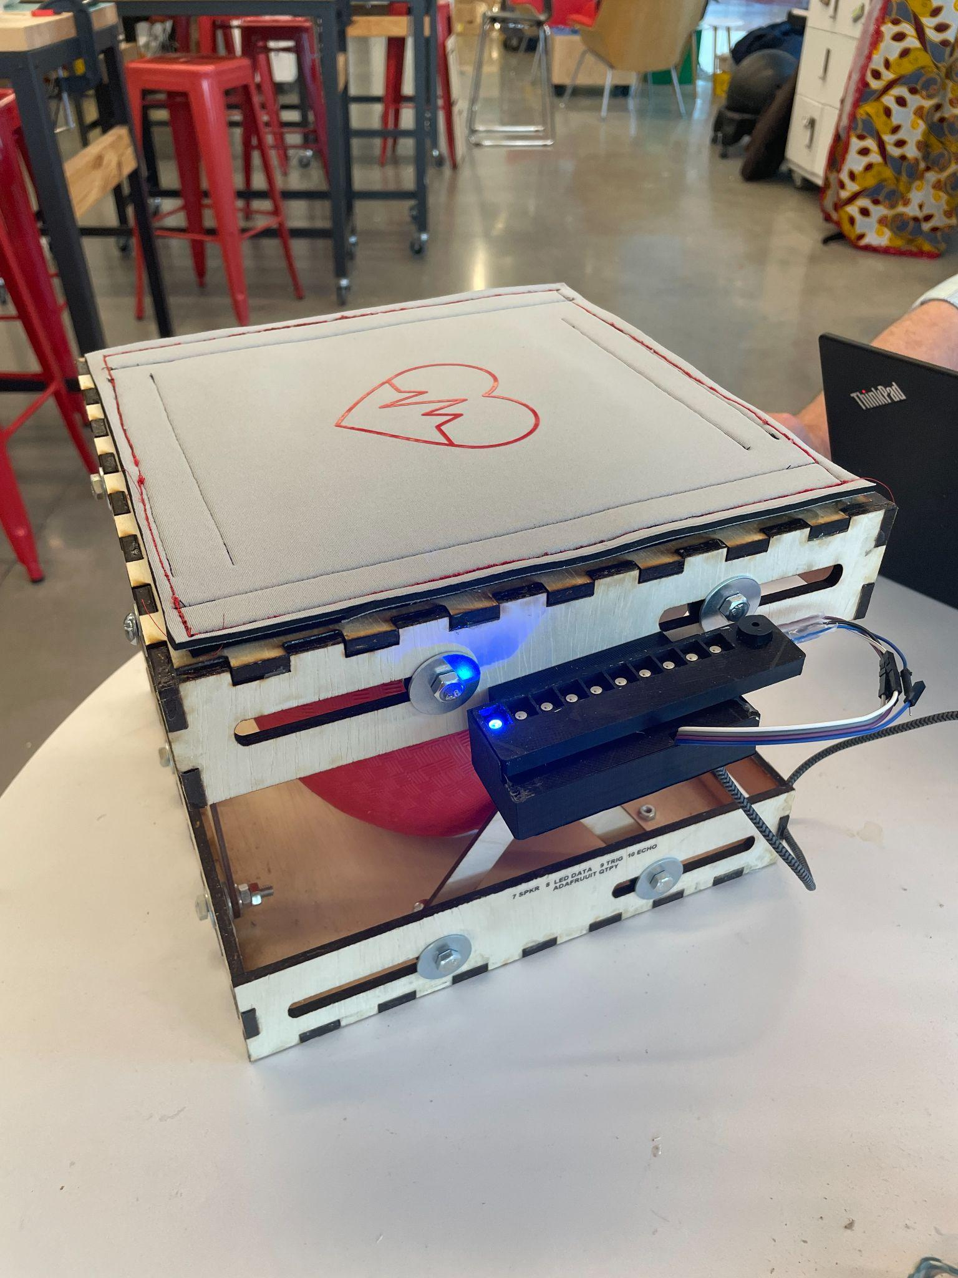
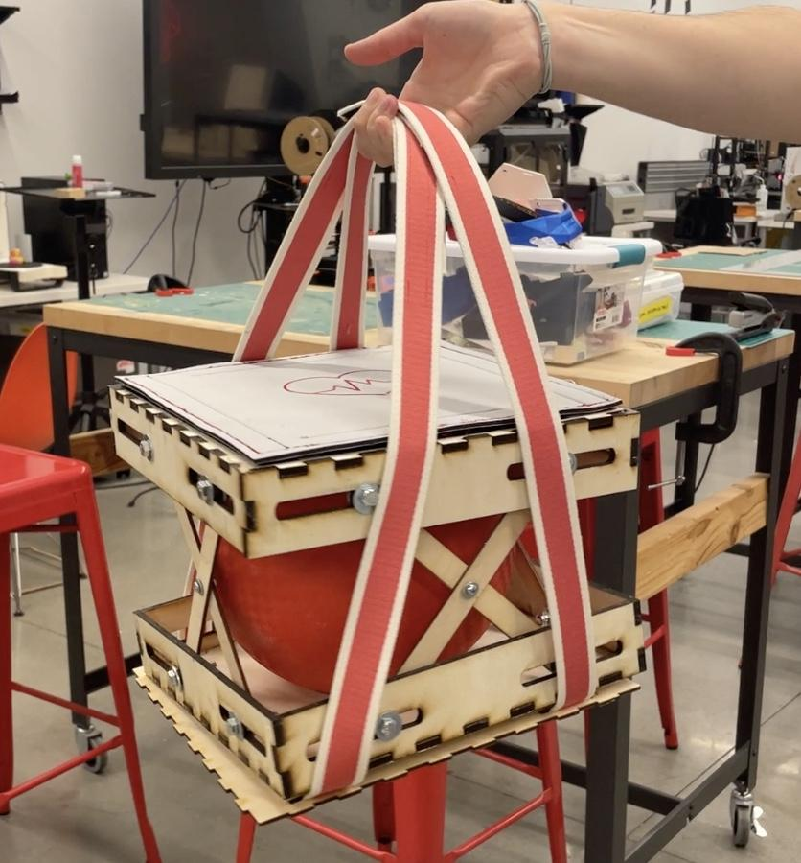
Final CPR Compression Trainer

Slide 11
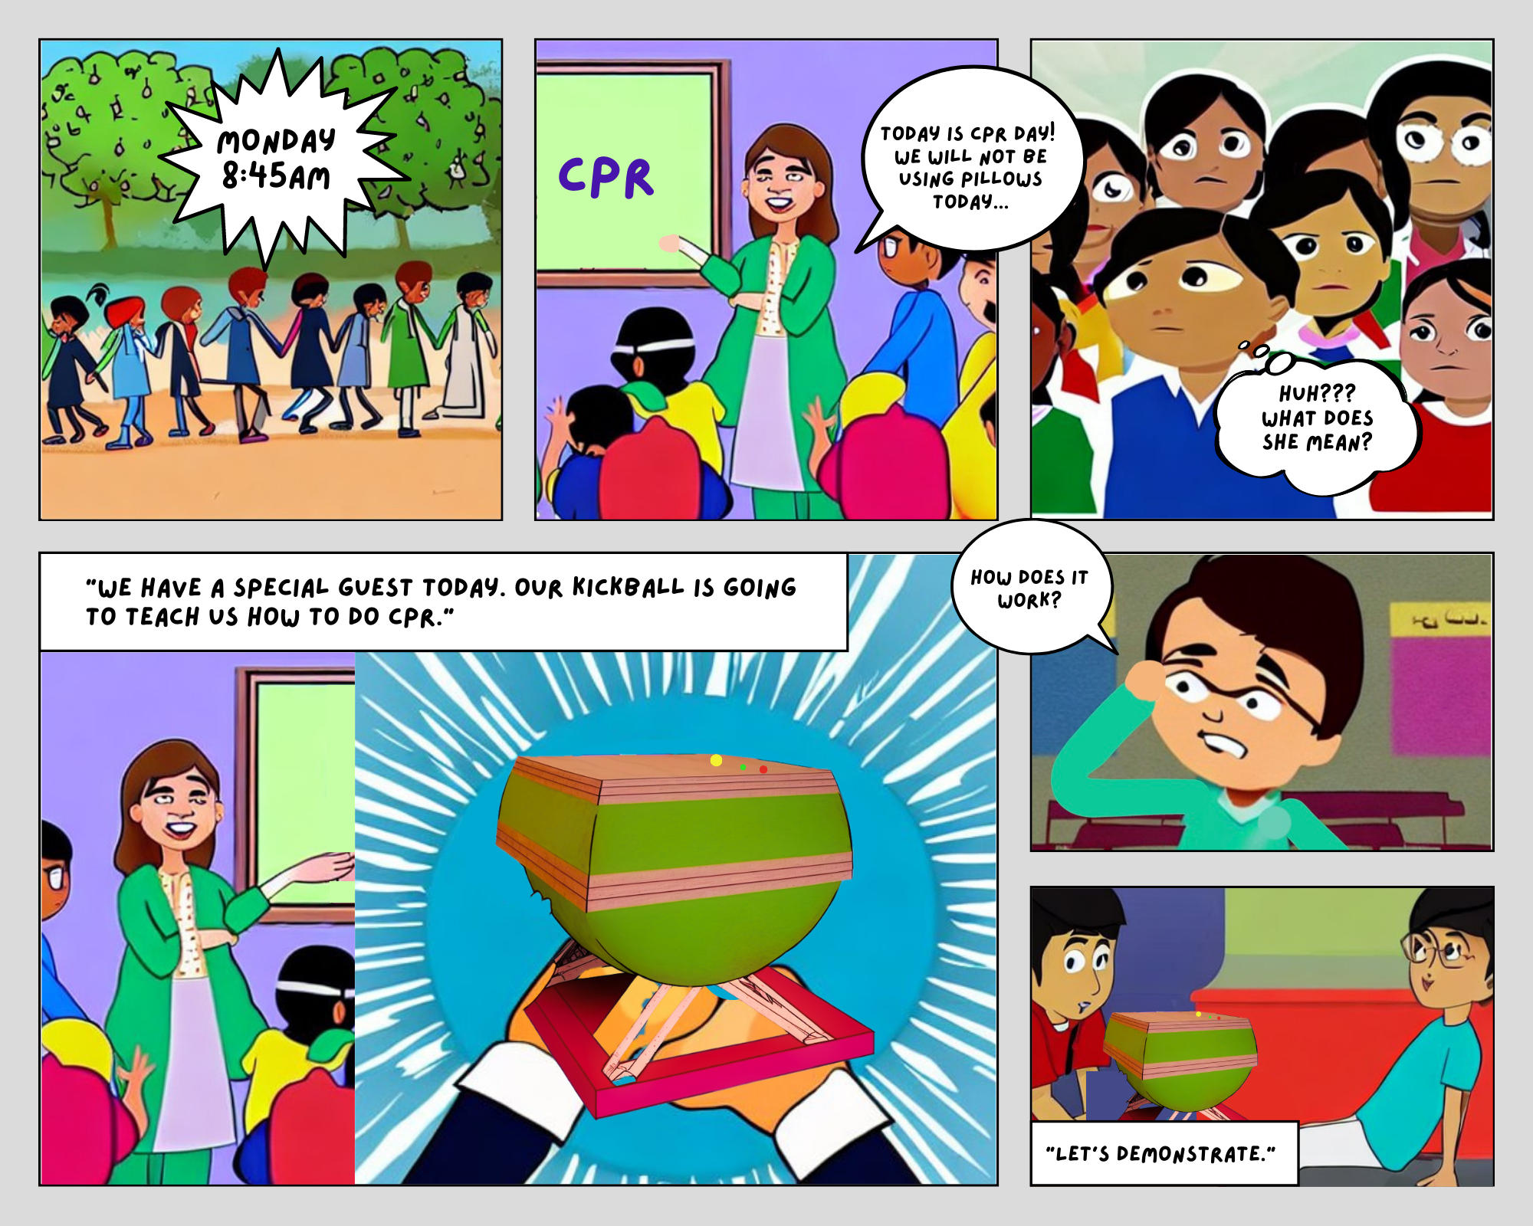

Slide 12
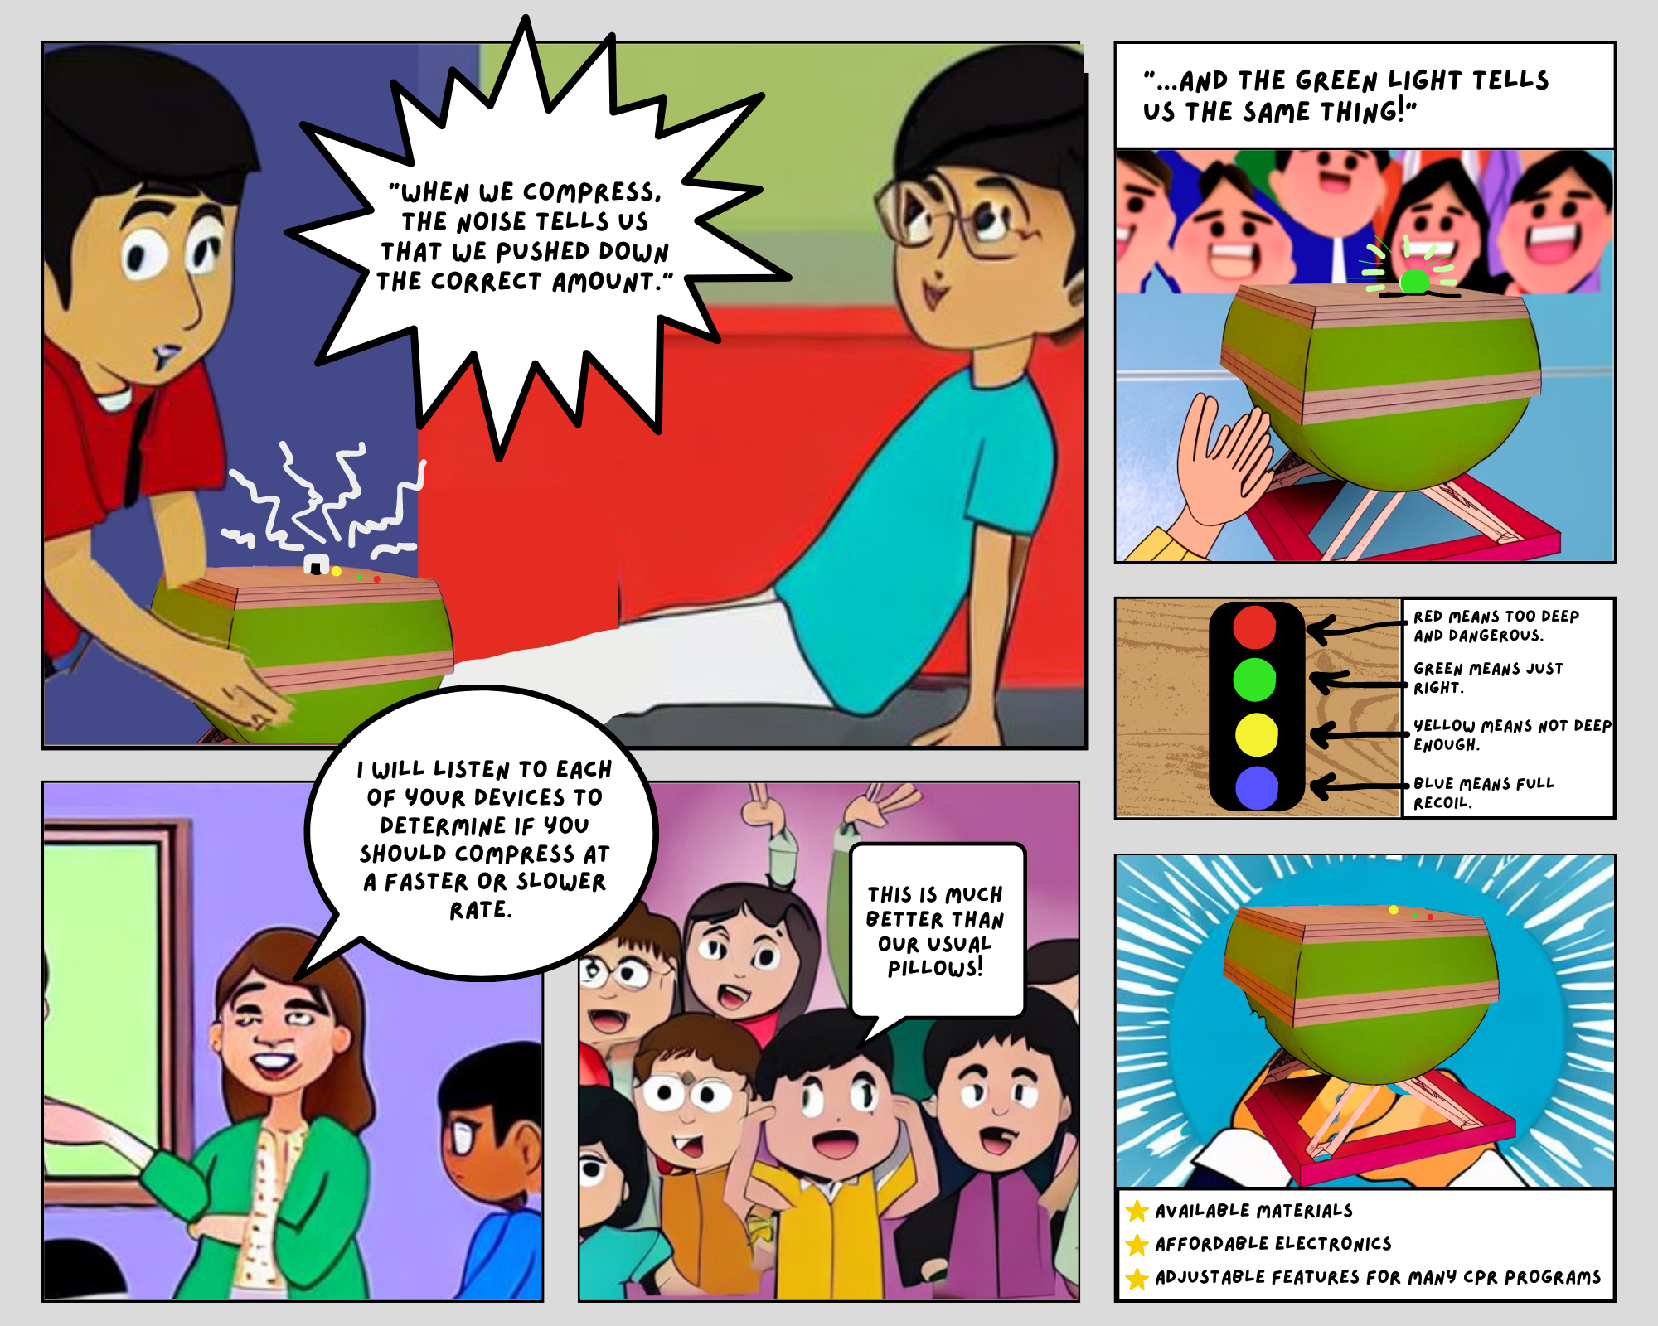

Slide 13
Our Design Process
Test
Test
Test
01
02
03
04
Build Compression Box
Add Electronics
Build Sturdier Model
Add Final Electronics
Kickball holder out of cardboard
Set-up sensor code and LED + audio feedback on compression depth
Laser cut wood for compression box
3D-printed pieces to hold electronics
Reposition and fasten electronics and all parts

Slide 14
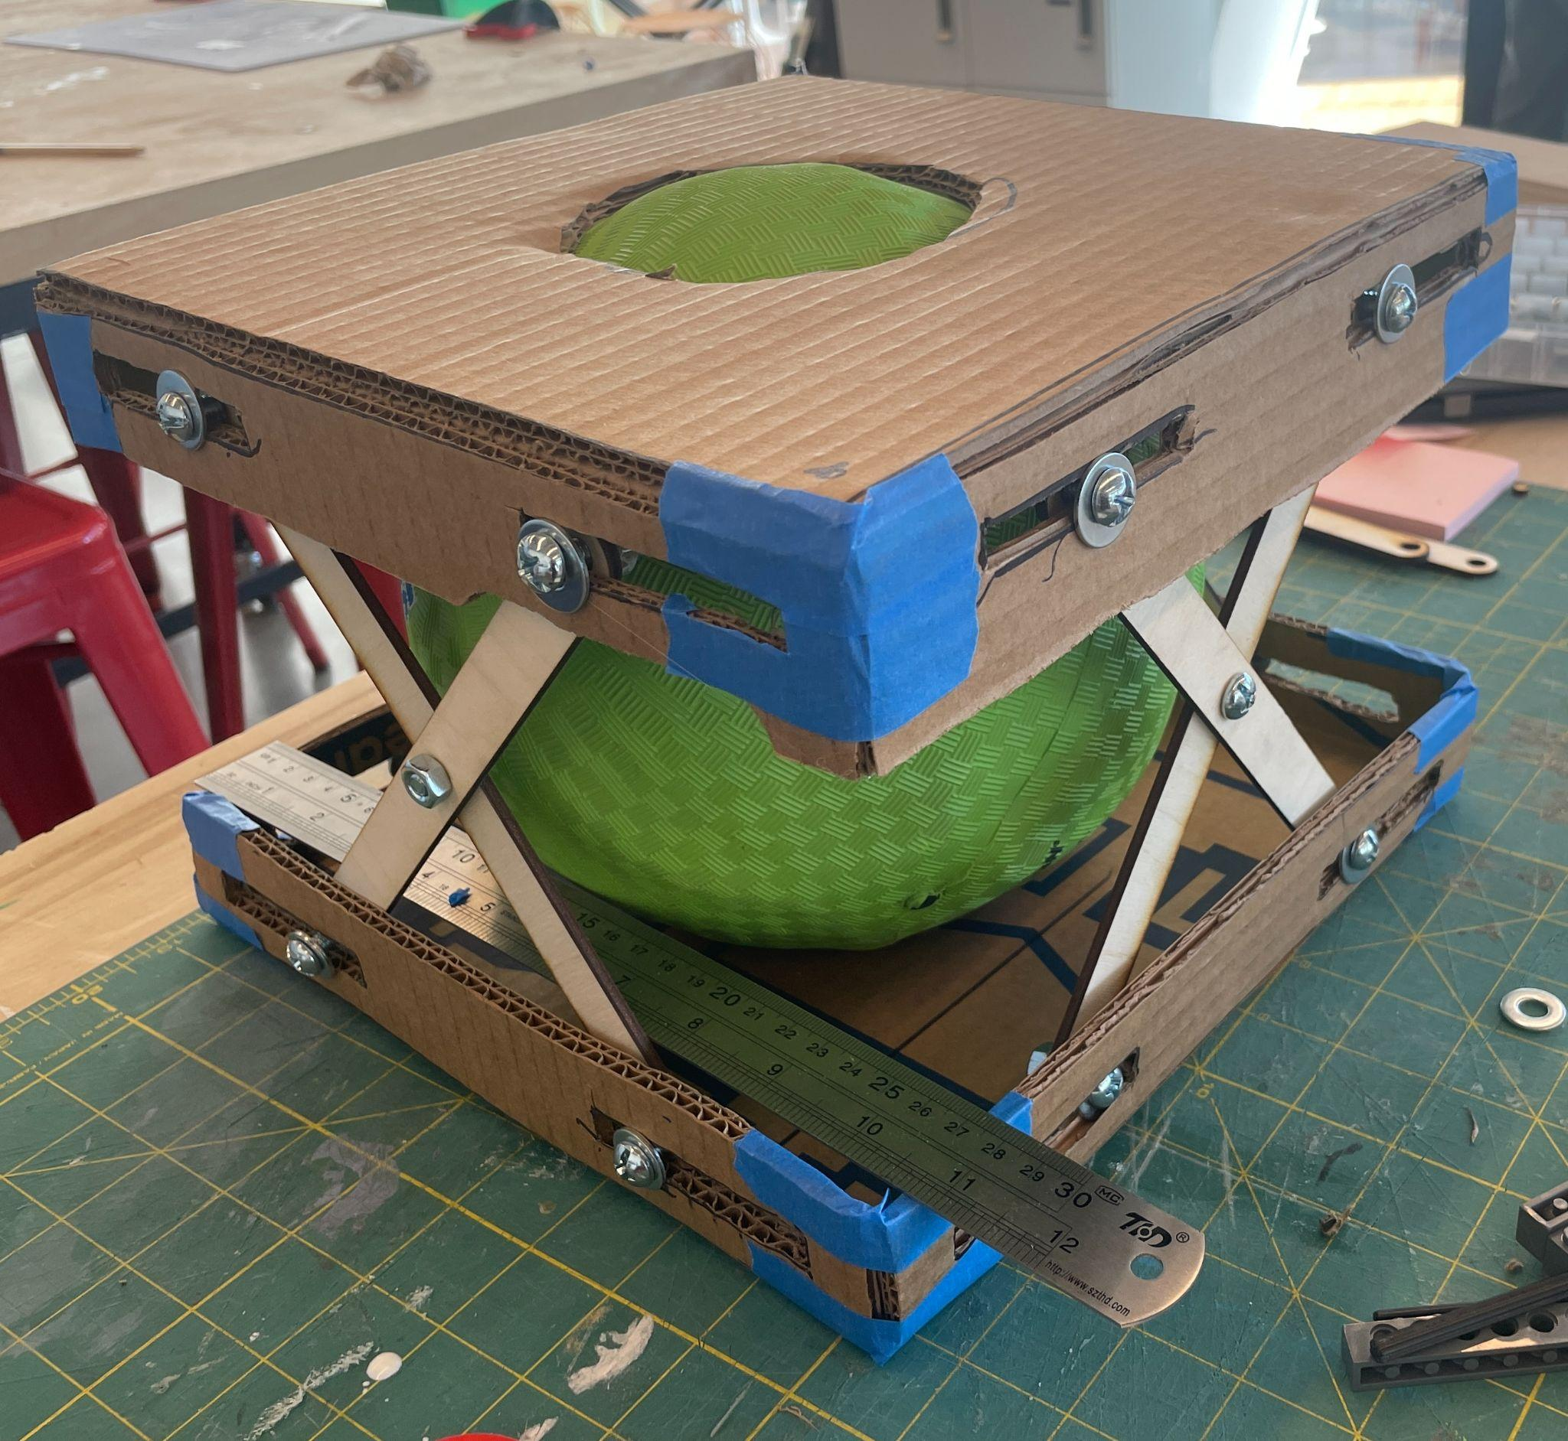
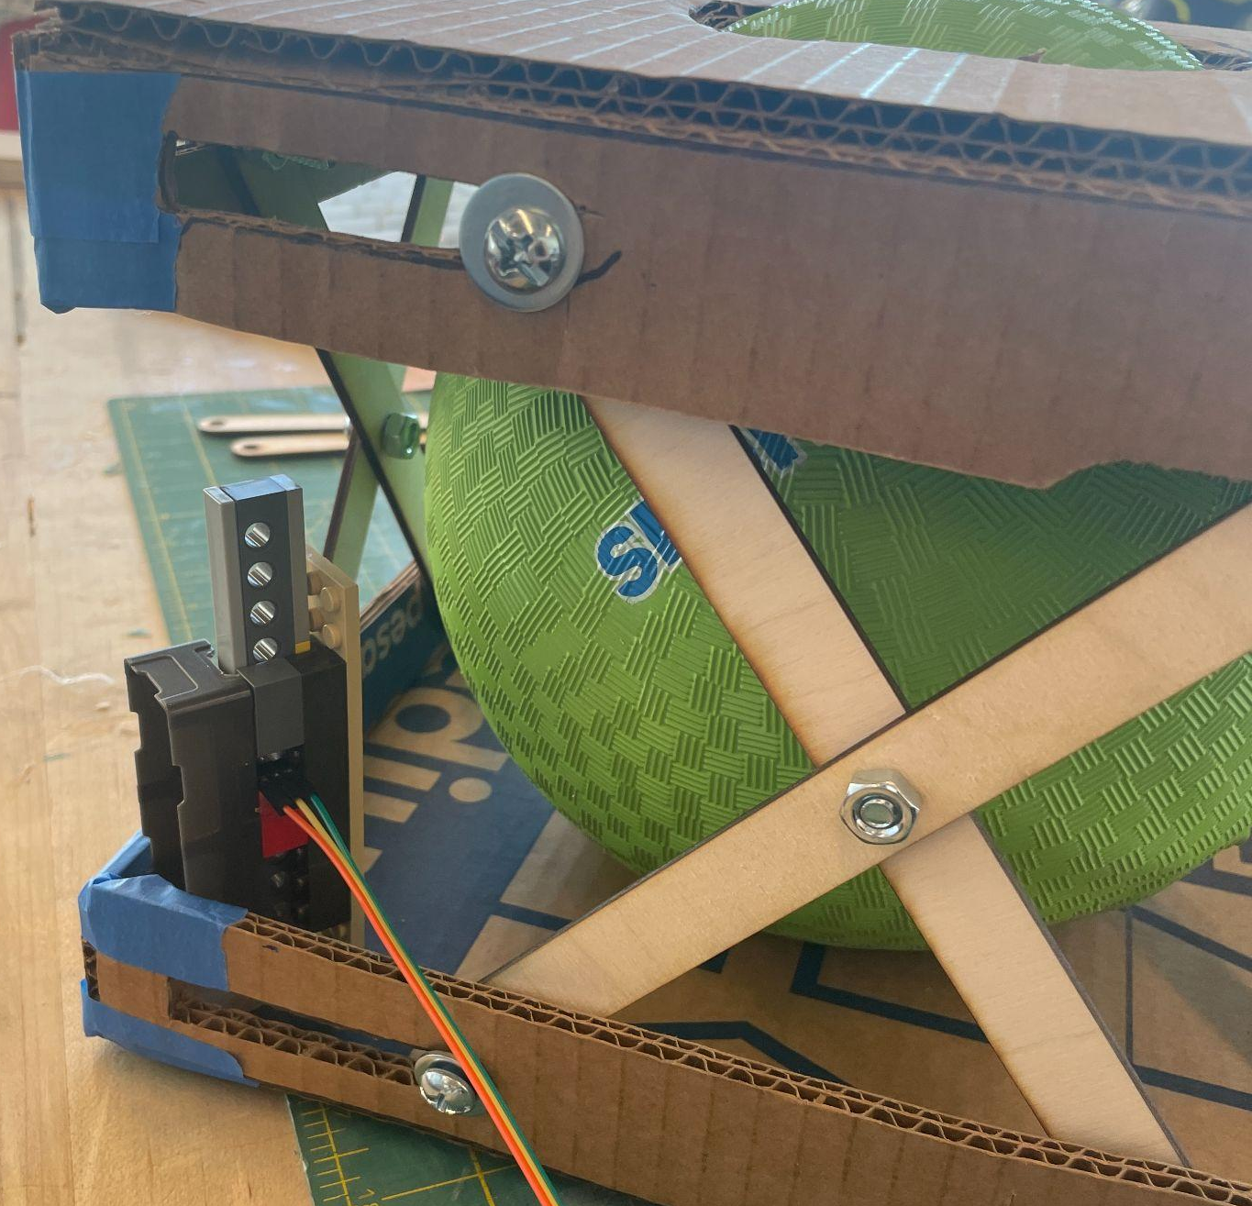
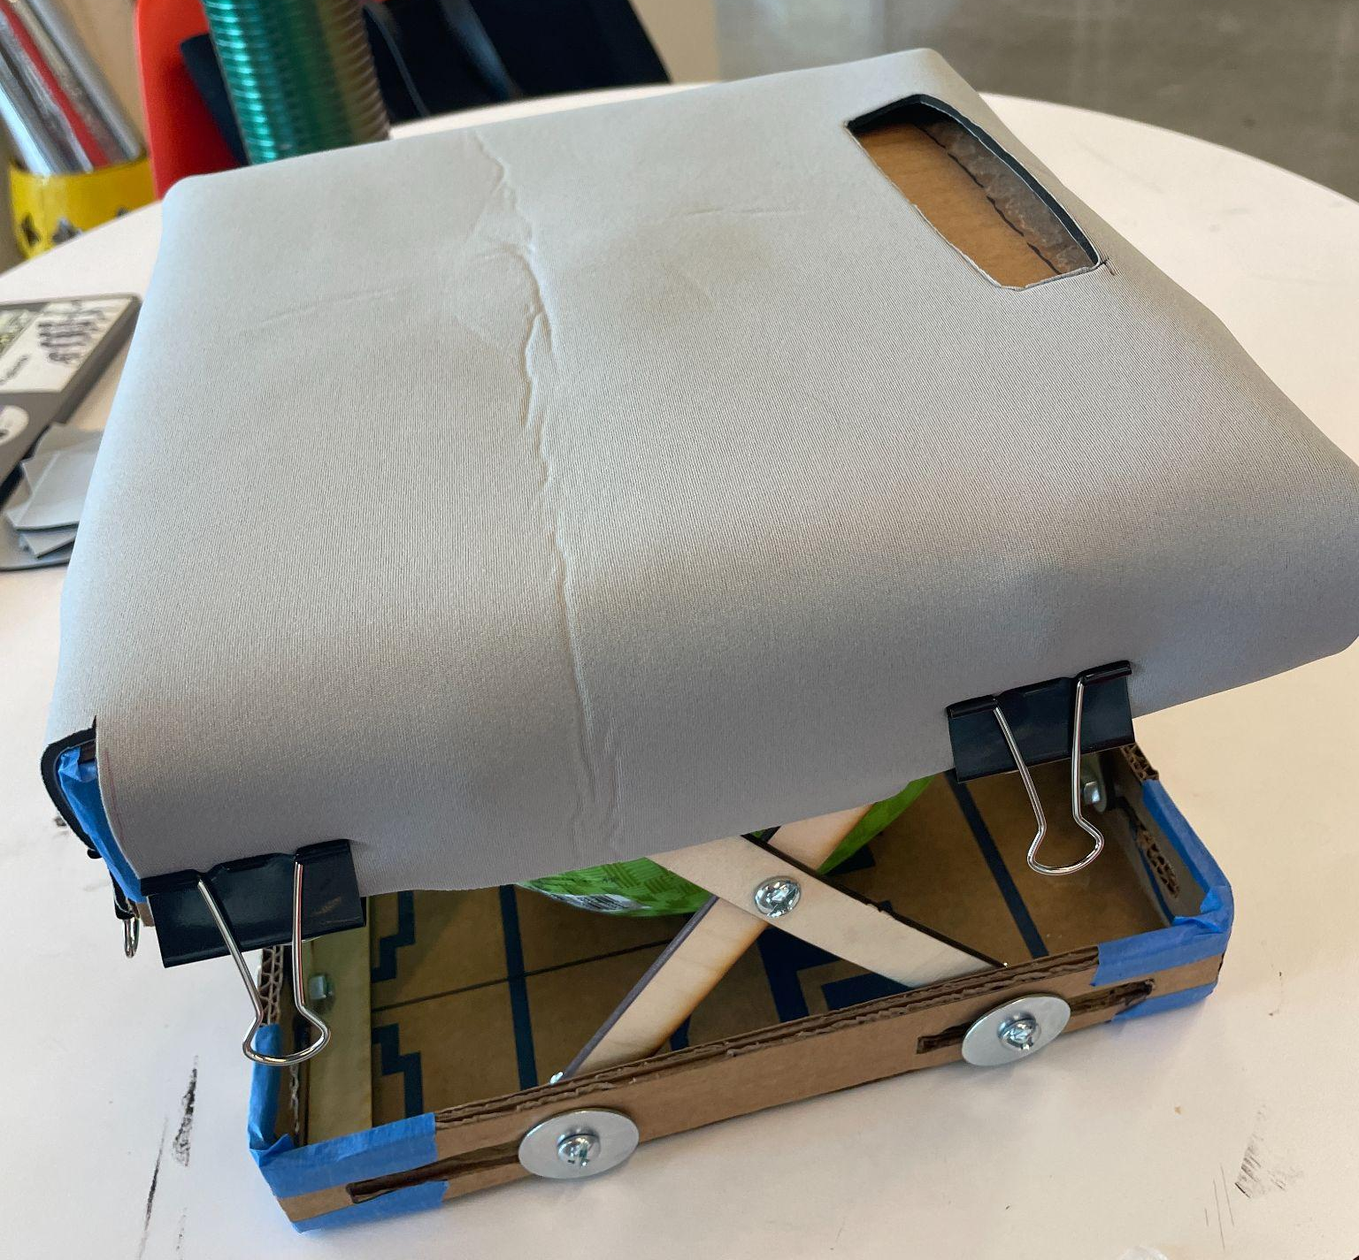
Cardboard Model
Scissors + cardboard
Laser cut wood
Nuts + bolts
Fabric cover
Learnings:
Realistic compressions
Withstands force
Considering electronics placement

Slide 15
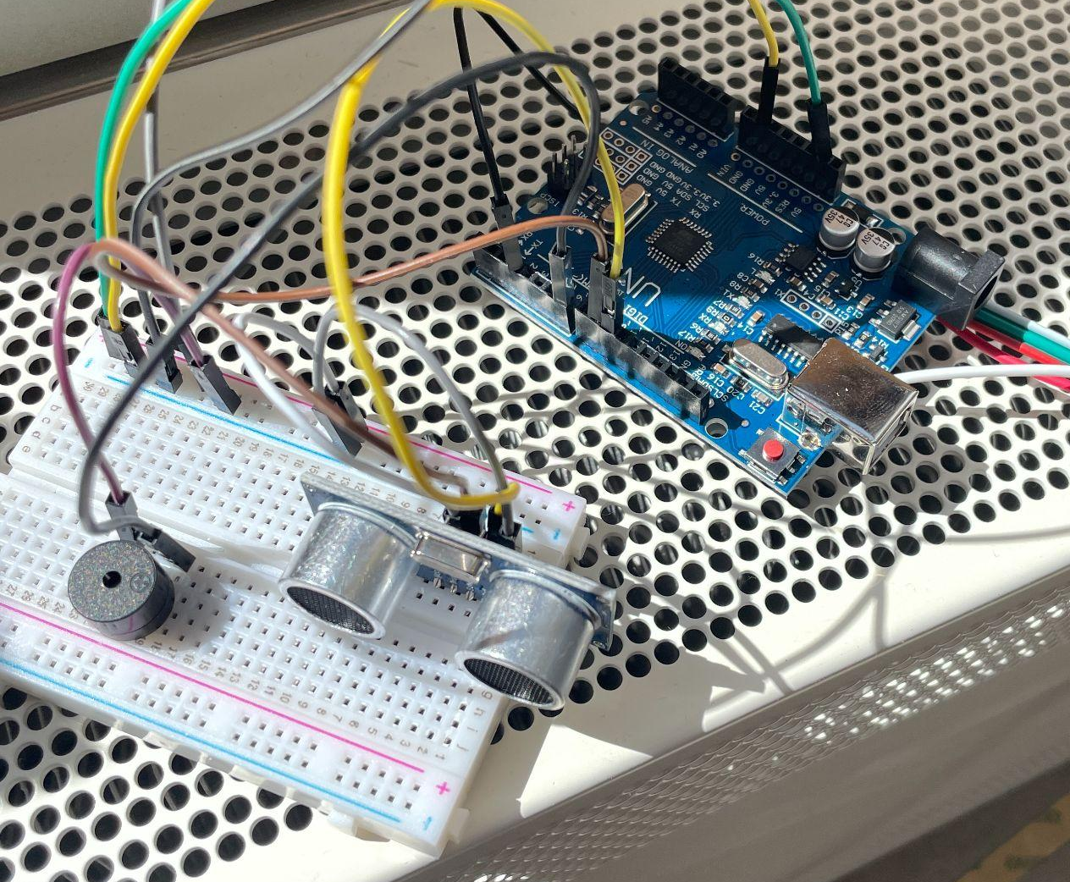


Cardboard Model
Electronics
Scissors + cardboard
Laser cut wood
Nuts + bolts
Fabric cover
Arduino + depth sensor + LED
Learnings:
Tune light and audio feedback to be less jerky
Finalize sensor placement
Consider portability & durability

Slide 16
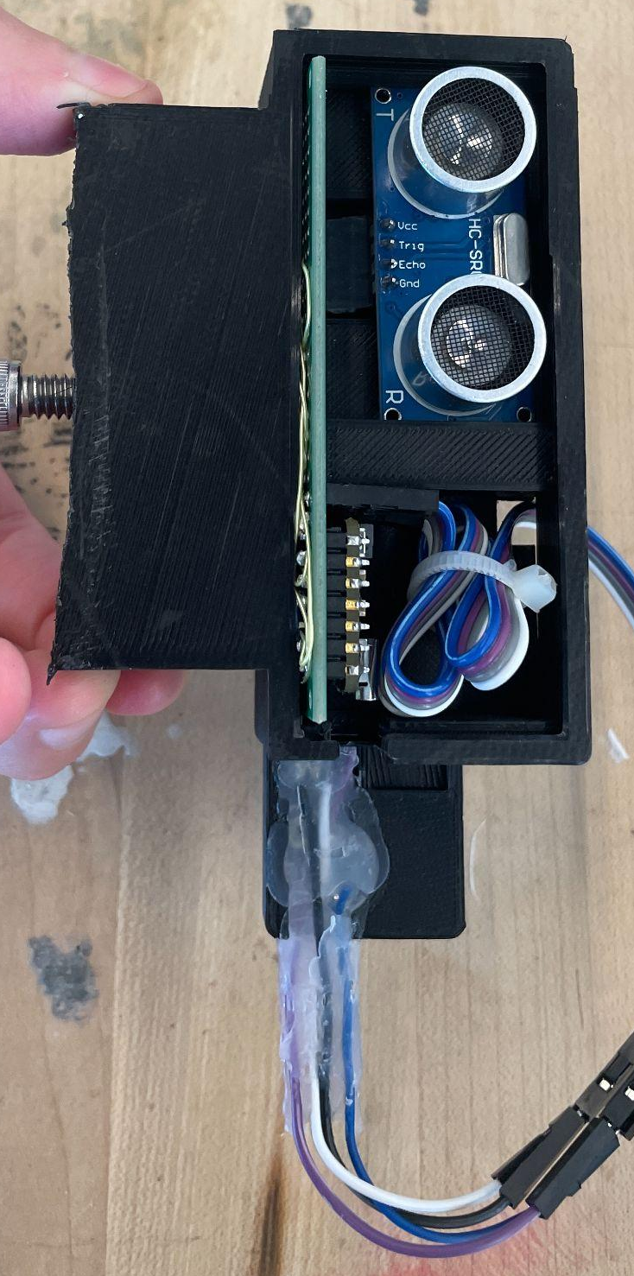
Final CPR Model
Scissors + cardboard
Laser cut wood + wood glue
Nuts + bolts
Fabric cover
Arduino + depth sensor + LED
3D-printed electronics holders
Sewn fabric + velcro straps
Learnings:
Relocate electronics
Position light feedback away from a user’s hand

Slide 17
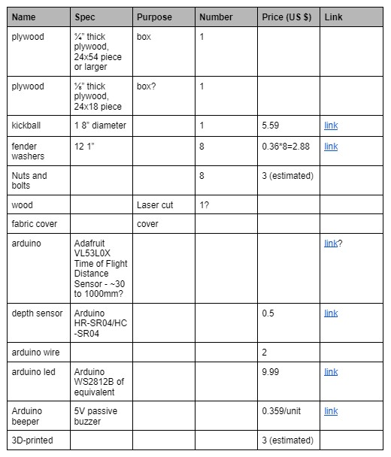
User Manual and Costs
$80
User manual (link)
Supplies
DIY instructions
Building process
Arduino code
Laser cut wood file
Estimated costs (below $80)
Keep improving our model for
May 19: Spring 2023 Open Studio
July 17: International Symposium on Academic Makerspaces 2023

Slide 18
Thanks!
Feedbacks and questions?

Slide 19
Our Roadmap
Track Chest Compression Displacement
Design & Print base kickball holder cup with feedback system holder
Design & Print feedback sensor stalk
Design & Implement feedback electronics
Assess & Tune feedback system sensor placement accuracy
Design & Print kickball stabilization cage
Hand placement feedback
Design & Print sternum/xyphoid process for tactile feedback
Design & Implement hand placement sensor
Assess & Tune usability
Physical operations of Object
Efficient placement and information selections for Feedback interface

